Slide 1
[ITM 618: Bank Marketing ]
Dr. Morteza Zihayat Kermani
Friday December 11, 2020
Arif Shash (500827924)
Husnain Khan (500934312)
Sukhkaran Grewal (500844346)
Notes:
Insert Your Header Here.

Slide 2


Project Objective
The datasets that we used helped us make predictions as to whether or not a client would subscribe to a term deposit with the financial institution. The data was split into two sets, a bank train set and a bank test set. Using the training data, we created three models using the classification model, then these same models were used on the bank test set to test said data. For each of the classification trees, a confusion matrix was implemented to calculate the projected accuracy of the models. We also used KNN models but their results were not very insightful.

Slide 3
Data Cleaning
Accuracy of Training Data Compared to Test Data
14.36%
Cleaning the Data
Code:
(Banktrainset [Banktrainset == "unknown"] <- "NA" , Banktestset [Banktestset == "unknown"] <- "NA")
Result:
All unknowns were changed and replaced with NA
Then again the classification tree was used and test predict on the cleaned data to create another decision tree and confusion matrix.
Accuracy:14.35%
Cleaning Data Even Further
Code:
(BanktrainnoNA <- na.omit(Banktrainset), View(BanktrainnoNA), BanktestnoNA <- na.omit(Banktestset),View(testnoNA))
Result:
Removed all the rows with “NA
Accuracy: 13.95%

Slide 4
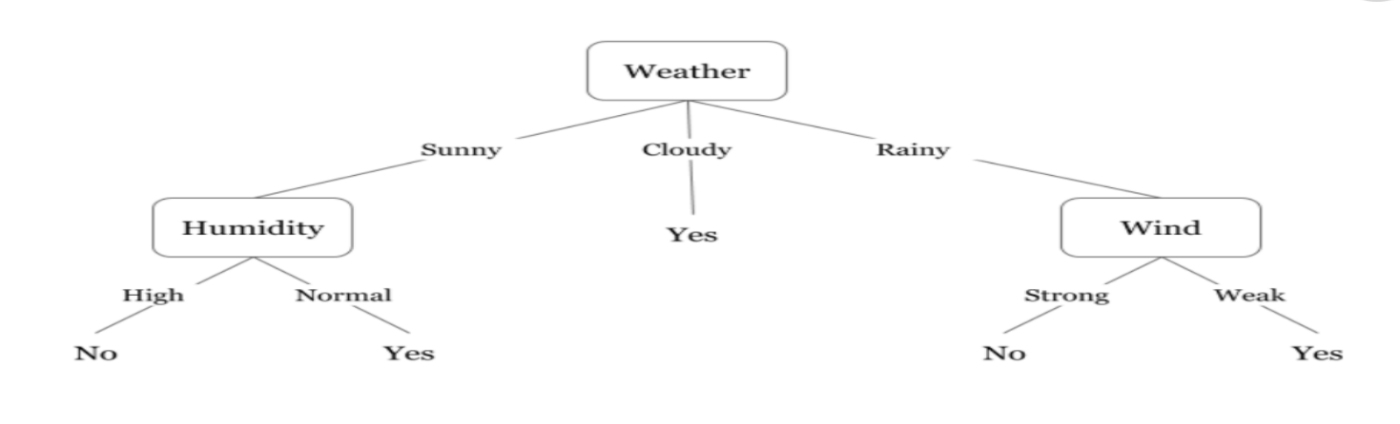
Learning Methods
Classification Tree:
The classification tree learning method can be used for categorical and continuous data. We chose to represent the results of the classification tree as models, 1, 2 and 3. Since our data was numerical and categorical the decision tree model was used to represent the data values
Figure 1: example of a decision tree

Slide 5
Learning Methods
Confusion Matrix :
For each decision tree model we used a confusion matrix. The confusion matrix acted to calculate the amount of True Negatives, True Positives, False Negatives, and False Positives values we had within our data
Confusion Matrix 1: Confusion Matrix 2:
Confusion Matrix 3:
Prediction | No | Yes
No | 267 | 0
Yes | 10206 | 1444
Prediction | No | Yes
No | 266 | 0
Yes | 10207 | 1444
Prediction | No | Yes
No | 256 | 0
Yes | 9523 | 1288

Slide 6
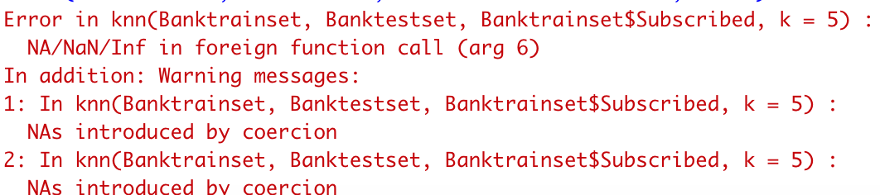
Learning Methods
KNN & KNNCAT:
The KNN method identifies the k-nearest neighbors using Euclidean distance and classifies new cases by which majority they are closest to. With our accuracy rates being low for the decision tree models this led us to conclude that using the KNN method would lead to greater accuracy rates for our decision trees
However, since the KNN method did not work with our data, we decided to use the KNNCAT which was more compatible with our data values.
Figure 2: Shows the error code for KNN

Slide 7
Learning Methods
KNN Imputation:
The KNN imputation function uses the k-nearest neighbours to fill in the unknown (NA) values in a data set. For each case with any NA value it will search for its k most similar cases and use the values of these cases to fill in the unknowns. We decided to use this approach for our data values. However, it was not compatible with our data.
Figure 3: Shows the error code for KNN Imputation:
#KNNImputation also did not work #KNNImputation(Banktrainset[, !names(Banktrainset) %in% "NA"]) : No case has missing values. Stopping as there is nothing to do.

Slide 8
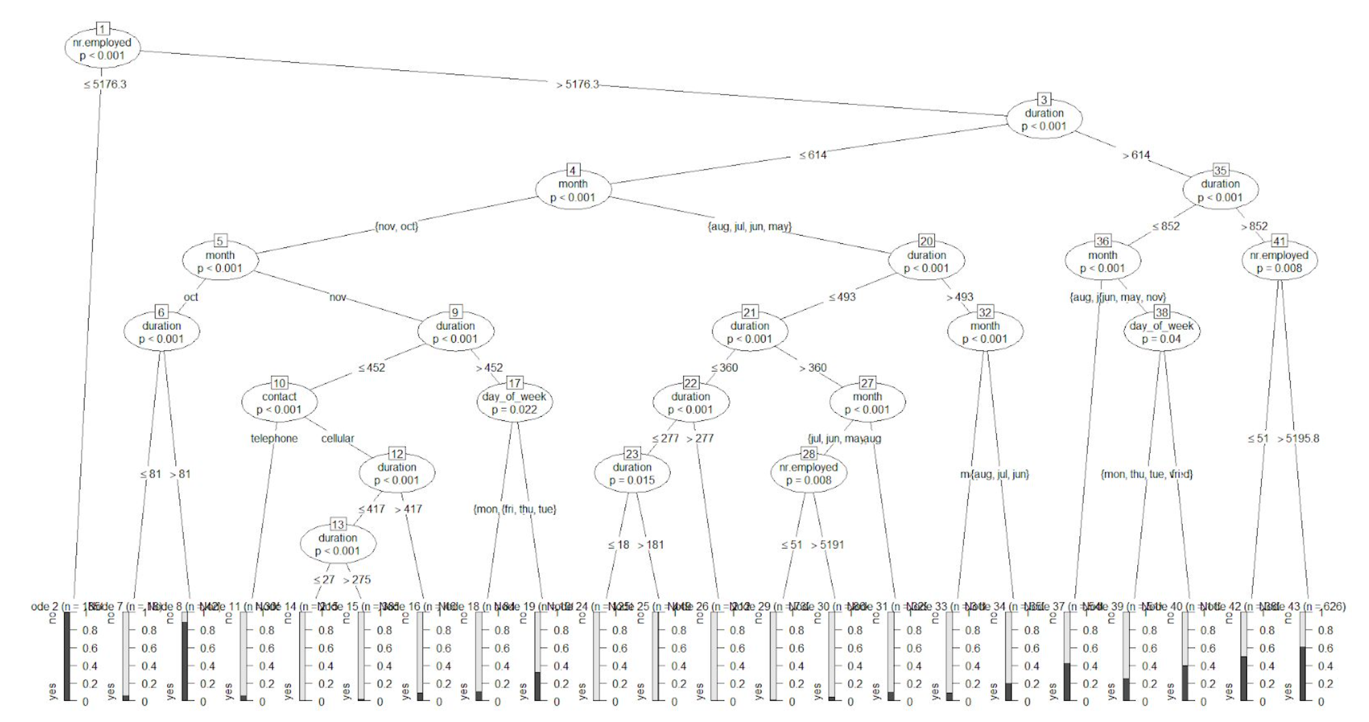
Evaluation
All the results regarding your model such as precision, recall, F-measure, error rate, AUC
Decision Tree 1 (Data Not Cleaned)
Confusion Matrix and Statistics
Reference
Prediction no yes
no 267 0
yes 10206 1444
Accuracy : 0.1436
Precision: 0.123948498
Recall:1
F-Measure: 0.139311788
Error Rate:0.8564
95% CI : (0.1373, 0.15)
No Information Rate : 0.8788
P-Value [Acc > NIR] : 1
Kappa : 0.0063
Mcnemar's Test P-Value : <2e-16

Slide 9
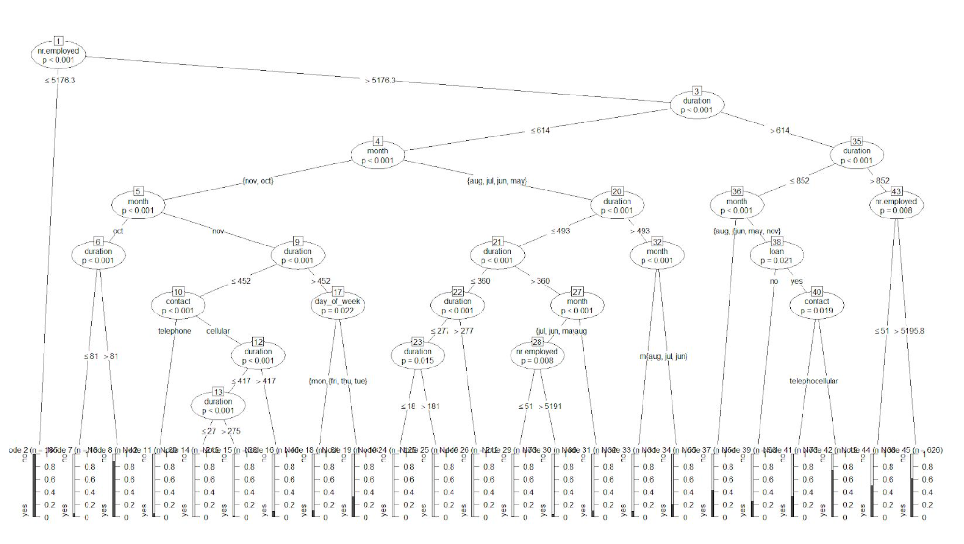
Evaluation
All the results regarding your model such as precision, recall, F-measure, error rate, AUC
Decision Tree 2 (Replace Unknown with N/A)
Confusion Matrix and Statistics
Reference
Prediction no yes
no 266 0
yes 10207 1444
Accuracy : 0.1435
F-Measure: 0.2190561
No Information Rate : 0.8788
Recall: 1
Precision: 0.123937859
Error Rate: 0.844444444
P-Value [Acc > NIR] : 1
Kappa : 0.0063
Mcnemar's Test P-Value : <2e-16

Slide 10
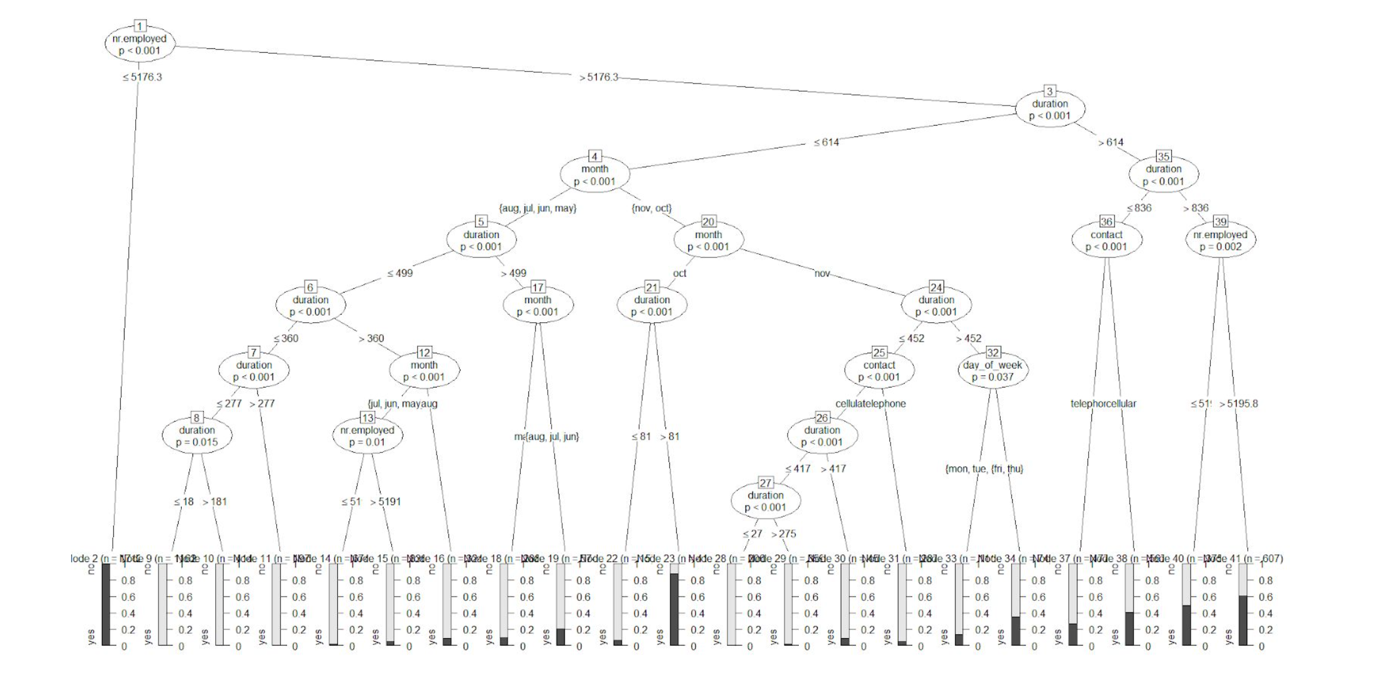
Evaluation
All the results regarding your model such as precision, recall, F-measure, error rate, AUC
Decision Tree 3 (Remove all fields with N/A)
Confusion Matrix and Statistics
Reference
Prediction no yes
no 256 0
yes 9523 1288
Accuracy : 0.1395
Precision: 0.112048717
Recall: 1
F-Measure: 0.249207264
Error Rate: 0.8605
95% CI : (0.1331, 0.1461)
No Information Rate : 0.8836
P-Value [Acc > NIR] : 1
Kappa : 0.0062
Mcnemar's Test P-Value : <2e-16

Slide 11
Discussions
What did you find about your model?
Is it a good model? Why?
The model that we used was not ideal as it had put us through various errors in predicting the accuracy of whether customers were likely to subscribe to a term.
How can you improve it?
We had tried to attempt to improve results through the cleaning of data. Upon each cleaning, we had realized that the accuracy had kept falling and so we determined it would not be beneficial to try and improve this model.

Slide 12
Conclusion and Future Work
Summary of what you did
We initially explored the data by deciding to clean it.
The goal of this exploration was to see how the cleaning of data would affect the accuracy rate of our data, which was done through a confusion matrix.
The results were not what we expected as the accuracy rate fell as opposed to going up. The accuracy rate of the data was ~ 14.35%.
We concluded that the KNN, KNNCAT, KNNImputation were not compatible with our data as it had led us into many loops of errors, negatively impacting our results.
What would you do in future to improve the models?
In the future, to improve the model we would have the KNN model work as without the KNN learning method our accuracy rate had been much lower than expected.

